Slide 1
CS50 Lab 2 Andrew Holmes

Slide 2
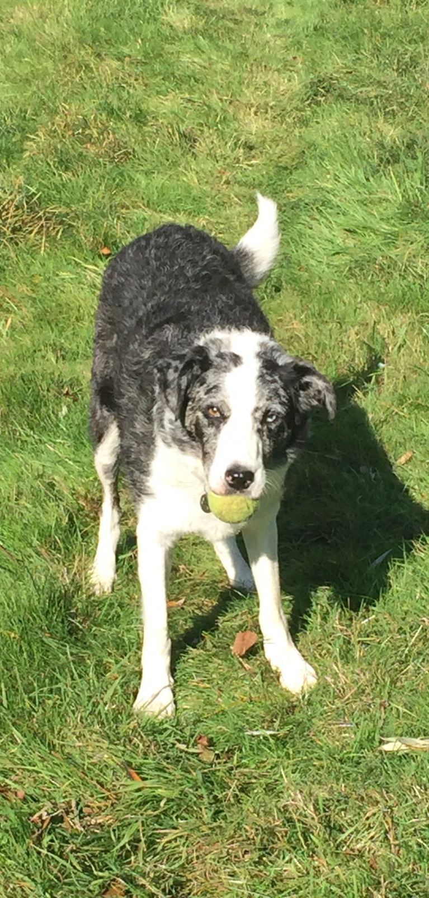
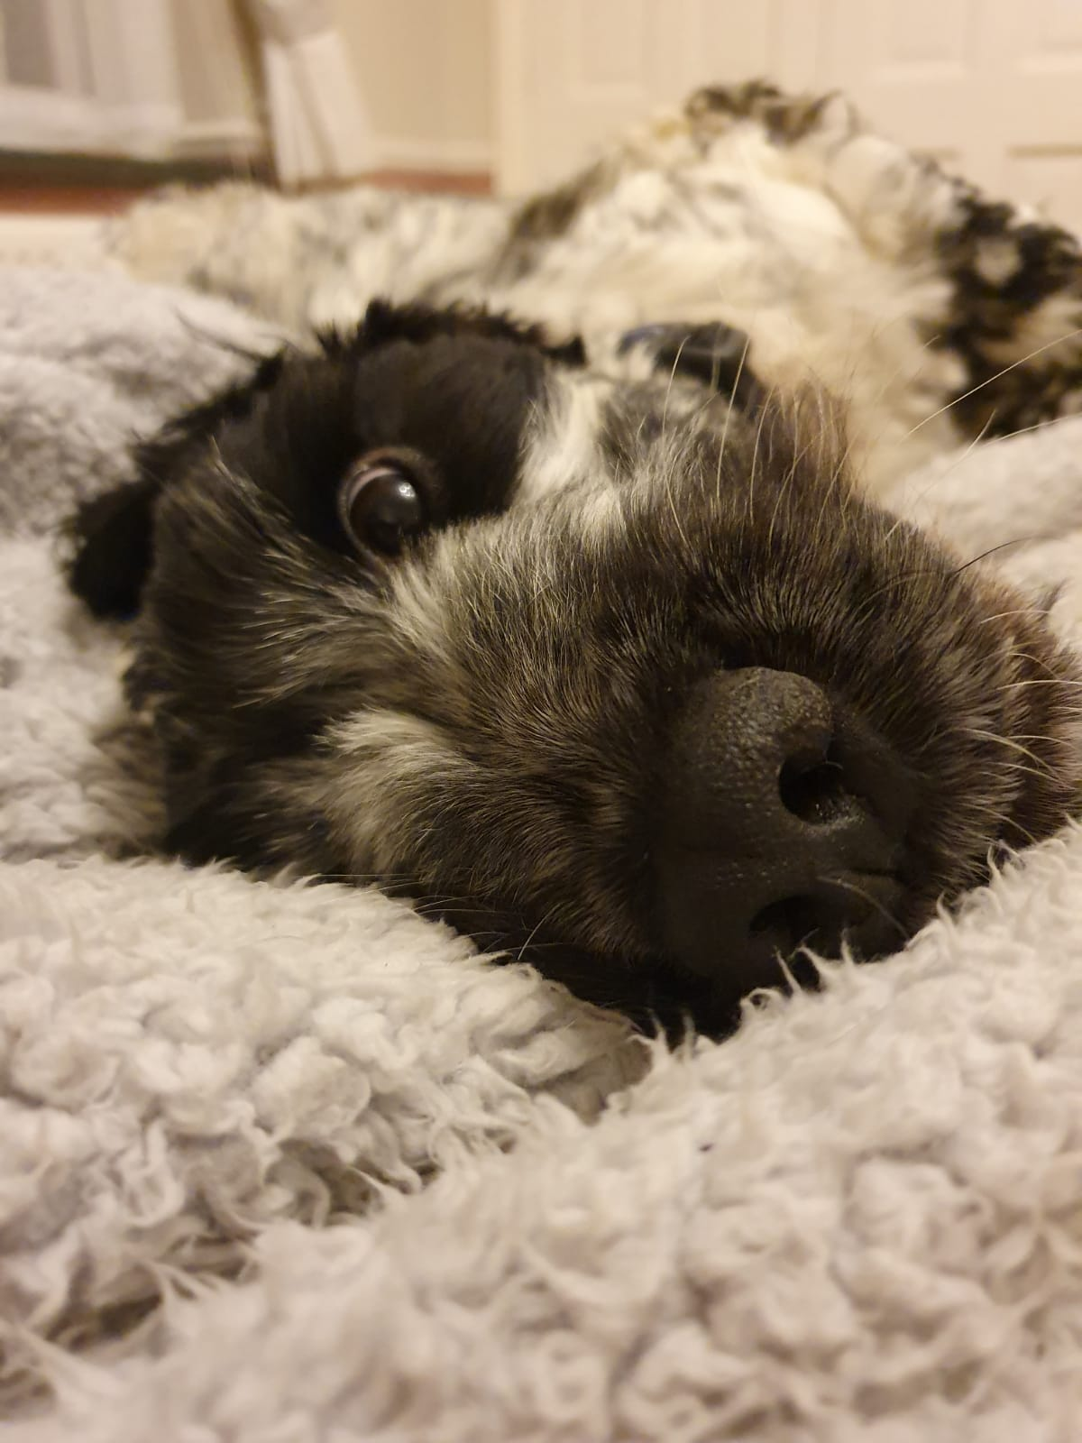
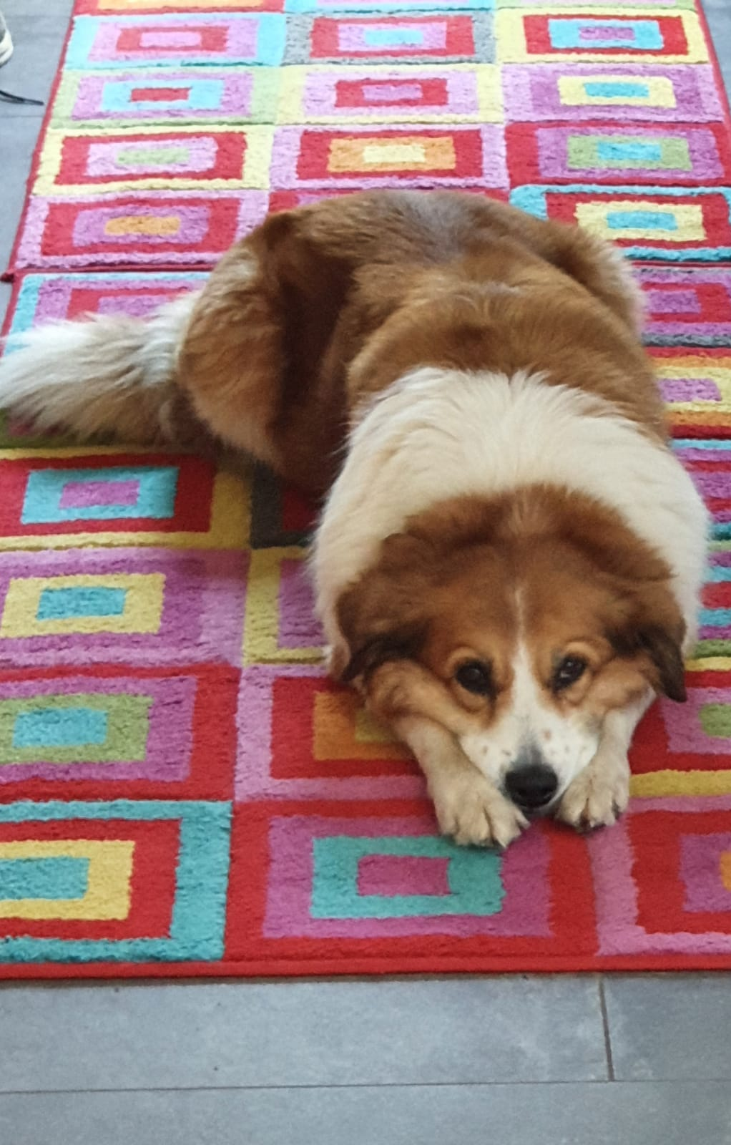
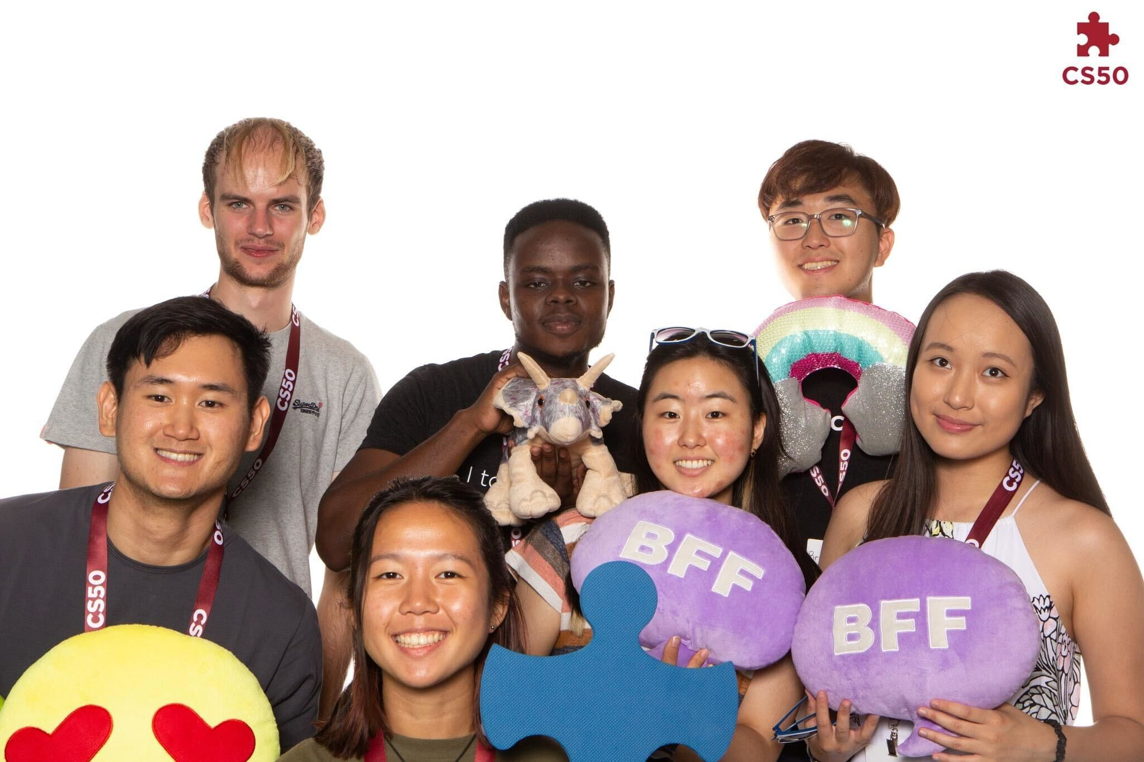
Intros :)
UK -> Cabot House :D
Computer Science (Physics & Spanish)
CA for CS50 last year, Peer Tutor for CS51
Soccer, running, 3D modelling, chess

Slide 3
Useful info
Tutorial time
5-6pm Pfoho dhall (can be hybrid, email me if needed)
Email
aholmes@college.harvard.edu
Slack
TBC if we want one?
Complaints email
Find Phyllis’ email on the cs50 webpage

Slide 4
Today’s Logistics
Intro (done!)
Intro exercise (your turn!)
Lecture/section topic recap
Quick review of common PSET mistakes
Lab problem - scrabble

Slide 5
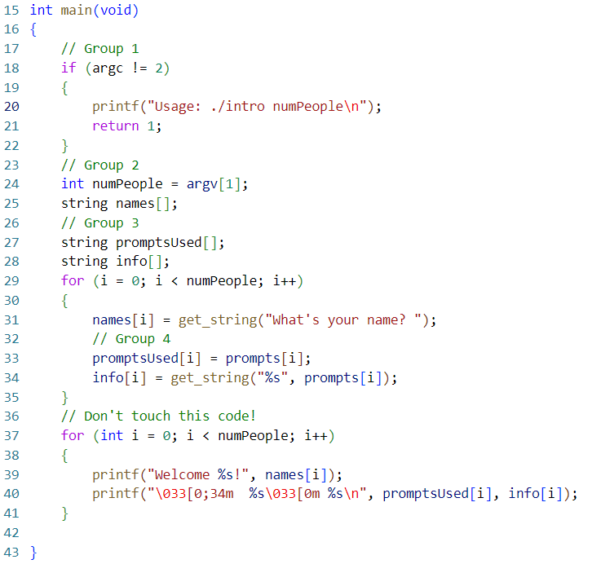
Intro exercise!
https://github.com/ACHolmes/CS50TF-2022F
Split into groups of 2-3
Find and fix bug(s) in your section
Then if you think you’ve fixed your section, start from the beginning and try to fix all the bugs

Slide 6
Lecture/Section review
Compiling
Pre-processing
Compiling
Assembling
Linking
Arrays
Initialization
Char store[6];
Insertion
Store[0] = ‘A’
Access
printf(“%c”, store[0]);

Slide 7
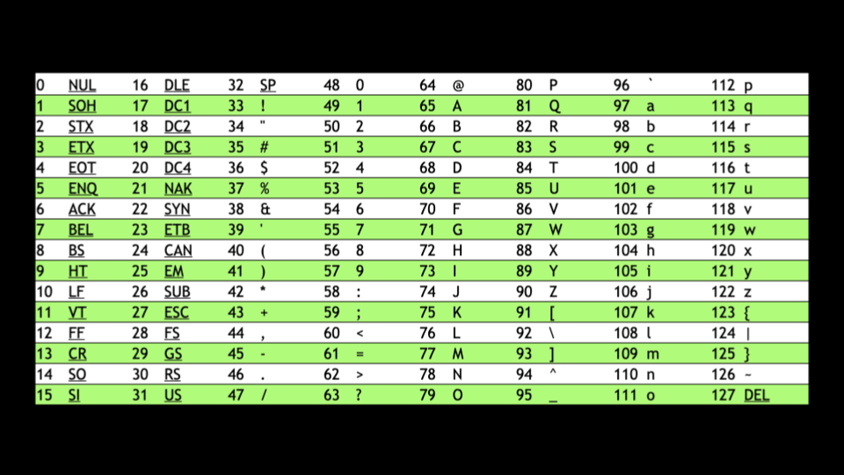
Lecture/Section review
Strings
Multiple chars
Can also be considered ints -> ASCII!
Many helpful functions in <string.h>!

Slide 8
Lecture/Section review
Command-line arguments
Int main(string argv[], int argc)!
Provide input to your program
argv[0] always name of your program
Each value in argv[1] is a string! Remember ./program 1, argv[1] is “1” not 1

Slide 9
Lecture/Section review
Return value
Int main(string argv[], int argc)!
Main returns an int
By default, 0
By convention, return other values for errors

Slide 10
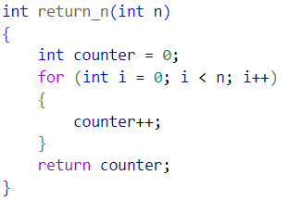
PSET design issues
Mario
Printf confusion
Do-while loops
Variable names
Overcomplicated maths
Cash
Efficient calculations
Redundant variables
Credit
Logical errors (that pass check50)
If-elses

Slide 11
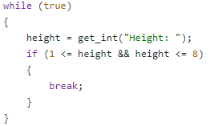
Mario design ideas
printf(" ");
printf(" ");
string s = “ “;
printf(“%s”, s);

Slide 12
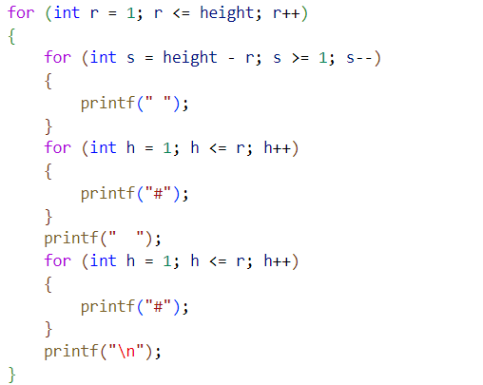
Overcomplicated maths/ variable names

Slide 13
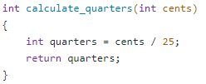
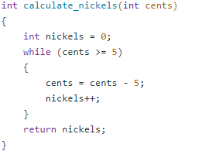

Cash design ideas

Slide 14
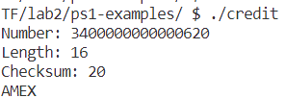
Credit design ideas
Question: is checking the length of the card and the type of the card separately safe?

Slide 15
Lab problem: Scrabble
Find the Scrabble value of a word!
https://cs50.harvard.edu/college/2022/fall/labs/2/
Work in pairs/small groups, we will reconvene shortly to see how everyone is getting on.

Slide 16
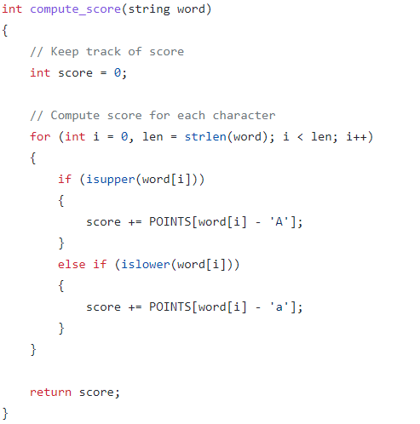
Scrabble solution

Slide 17
PSET 2 pointers
Bulbs
New PSET for this year! (friend of mine made it)
Can be very short, think about converting from decimal to binary carefully.
Caesar
Encryption is cool! Might some of the tricks from the intro exercise (especially usage of %) be useful to you?
Some functions from the CS50 manual may help you! See the manual pages here: https://manual.cs50.io/ (e.g. isdigit!)
Wordle50
It’s wordle!
More guidance provided than substitution, slightly easier imo
Substitution
Like Caesar, very ASCII focused. A little trickier, and better practice with arrays
Still very doable! How to keep track of whether every character in key is unique? Perhaps some bools…? How many of them…?

Slide 18
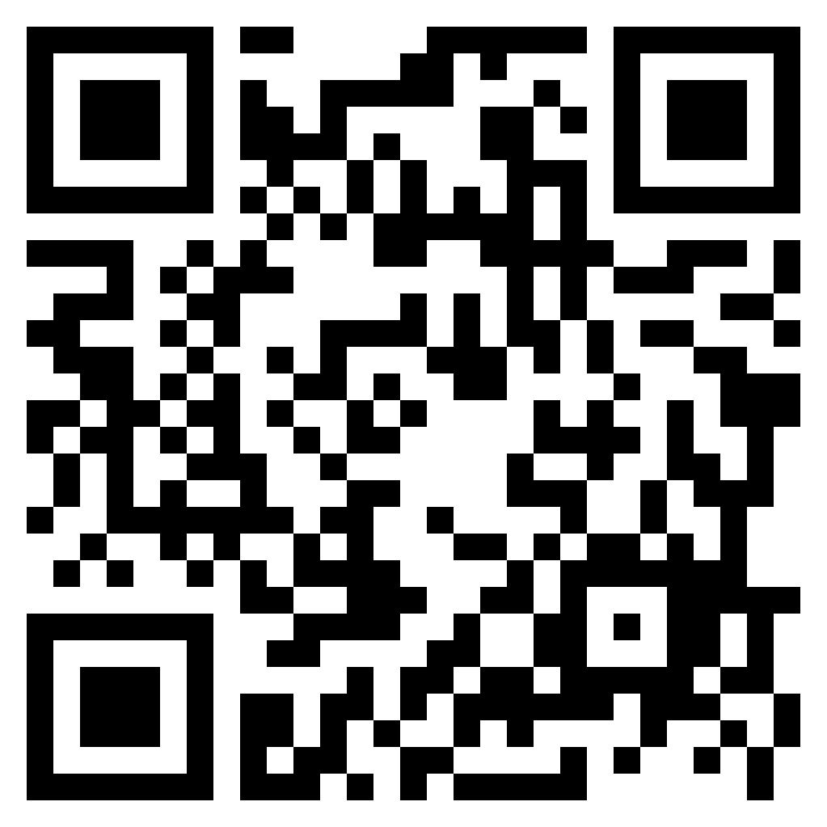
Final notes
Please fill out form: https://forms.gle/VHQQh5gatJ5PC4CQ7
Expect a Google Form in your inbox around Tue/Weds to see what topics people want me to (briefly) cover in next week’s lab

Slide 19

Cya next week :D

